Slide 1
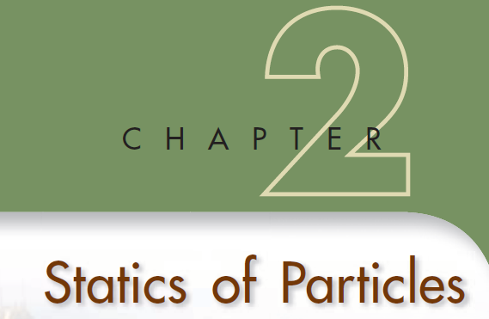

Slide 2

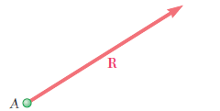
A force represents the action of one body on another and is generally characterized by its point of application , its magnitude , and its direction. Forces acting on a given particle, however, have the same point of application. Each force considered in this chapter will thus be completely defined by its magnitude and direction.
Vectors are defined as mathematical expressions possessing magnitude and direction, which add according to the parallelogram law.
ADDITION OF VECTORS
The diagonal that passes through A represents the sum of the vectors P and Q , and this sum is denoted by P + Q

Slide 3
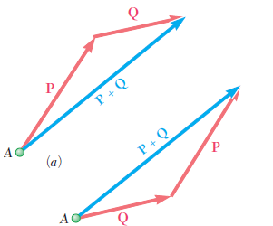
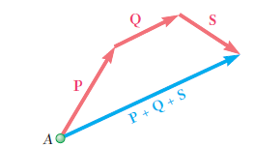
From the parallelogram law, we can derive an alternative method for determining the sum of two vectors. This method, known as the triangle rule ,
The sum of the two vectors can thus be found by arranging P and Q in tip-to-tail fashion and then connecting the tail of P with the tip of Q .s
sum of the three vectors could have been obtained directly, as shown in Fig., by arranging the given vectors in tip to- tail fashion and connecting the tail of the first vector with the tip of the last one. This is shown as the polygon rule for the addition of vectors.

Slide 4
Resolution of a Force into components
The process of splitting up the given force in to a number of components, without changing its effect on body is called resolution of a force.

Slide 5
Resolution along any two directions ( Not mutually perpendicular)
Y’
F
α
α + β ≠ 90º
β
O
x’

Slide 6
Y’
Fy
F
α
α
Fy
β
O
180 – α - β
Fx
x’

Slide 7



=
=

Slide 8
Resolution into Rectangular components (mutually perpendicular)
Most common 2D resolution of a force vector
Express in terms of unit vectors ,

Slide 9
y
θ
x

Slide 10
Scalar components – can be positive and negative

Slide 11
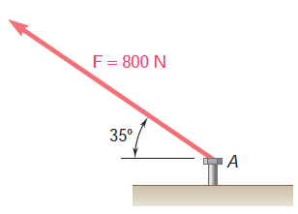
1) A force of 800 N is exerted on a bolt A as shown in Figure. Determine the horizontal and vertical components of the force

Slide 12
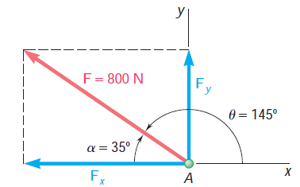



Slide 13
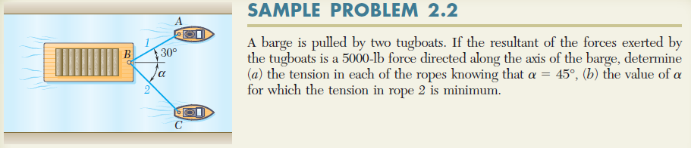


Slide 14
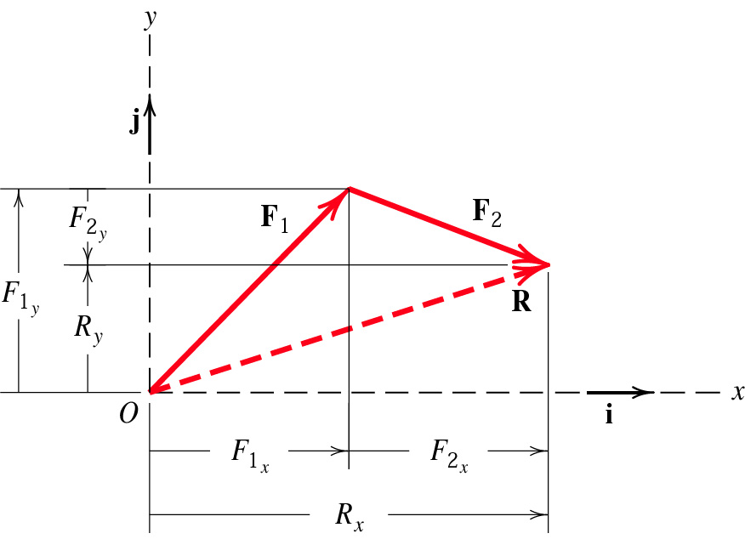
RECTANGULAR COMPONENTS OF A FORCE.
Rectangular components are convenient for finding the sum or resultant of two (or more) forces which are concurrent
Two vectors of unit magnitude, directed respectively along the positive x and y axes, will be introduced at this point. These vectors
are called unit vectors and are denoted by i and j , respectively

Slide 16
S
P
A
Q
R = P + S + Q

Slide 17
Sy j
Py j
S
P
Sx i
Px i
A
Qx i
Qy j
Q
R = P + S + Q

Slide 18
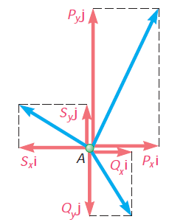


Slide 19
Ry j
Rx i
A
Rx = Px + Sx + Qx Ry = Py + Sy + Qy
Rx = ∑Fx Ry = ∑Fy

Slide 20
1. Determine the magnitude and direction of the resultant of five forces. Specify its direction measured counter clockwise from the positive x axis.
F2 = 50 kN
F1 = 40 kN
F3 = 60 kN
70
50
60
50
F5 = 55 kN
F4 = 45 kN

Slide 21
F2 = 50 kN
F1 = 40 kN
F3 = 60 kN
70
50
60
50
F5 = 55 kN
F4 = 45 kN

Slide 22
Fy = 40 sin50
F1 = 40 kN
50
Fx = 40 cos 50

Slide 23
F2 = 50 kN
Fx = 50 sin 90
Fx = 50 cos 90

Slide 24
F3 = 60 cos 70
F3 = 60 kN
70
F3 = 60 sin 70

Slide 25
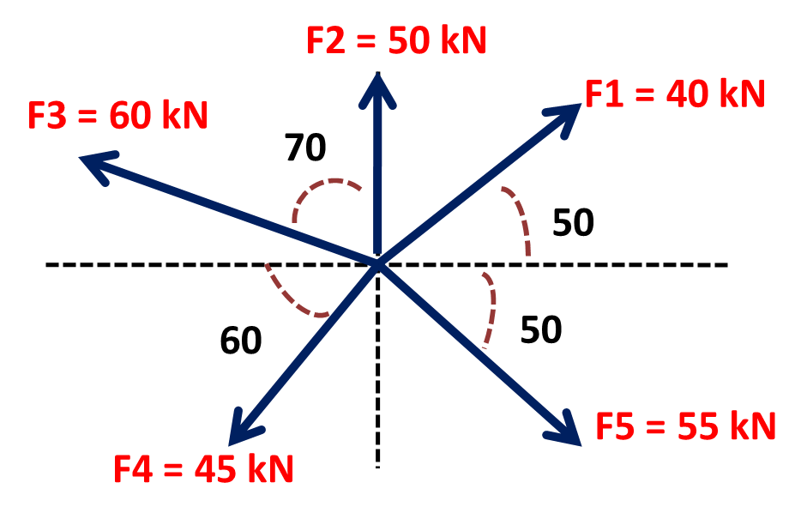
Sr. No. | Force | x- component | y- component
1 | F₁ = 40 kN | 40 cos50◦ | 40 sin50◦
2 | F₂ = 50 kN | 50 cos90◦ | 50 sin90◦
3 | F₃ = 60 kN | - 60 sin70◦ | 60 cos70◦
4 | F₄ = 45 kN | -45 cos60◦ | - 45 sin60◦
5 | F₅ = 55 kN | 55 cos50◦ | - 55 sin50◦
 |  | Rx = -17.32 | Ry = 20.06

Slide 26
Sr. No. | Force | x- component | y- component
1 | F₁ = 40 kN | + 25.71 | + 30.64
2 | F₂ = 50 kN | 0 | + 50.00
3 | F₃ = 60 kN | - 56.38 | + 20.52
4 | F₄ = 45 kN | -22.50 | - 38.97
5 | F₅ = 55 kN | +35.35 | - 42.13
 |  | Rx = -17.32 | Ry = 20.06

Slide 27
R = R_{x} i + R_{y} j
R = (-17.32 kN) i + (20.06 kN) j

Slide 28
R = (-17.32 kN) i + (20.06 kN) j

Slide 29
F2 = 50 kN
F1 = 40 kN
F3 = 60 kN
70
50
60
50
F5 = 55 kN
F4 = 45 kN

Slide 30
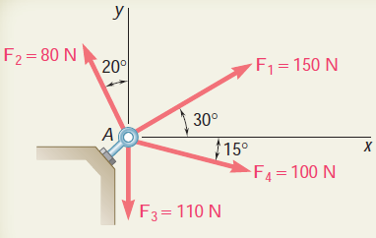
2. Four forces acts on bolt A as shown. Determine the resultant forces on the bolt.
R = 199.6 N

Slide 31
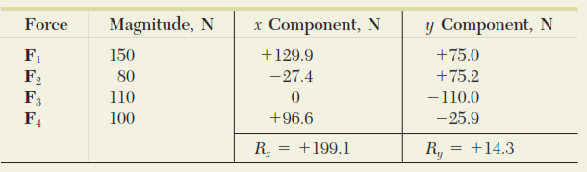




Slide 32
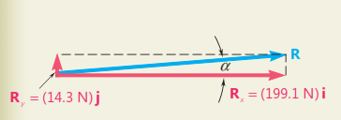

Slide 33

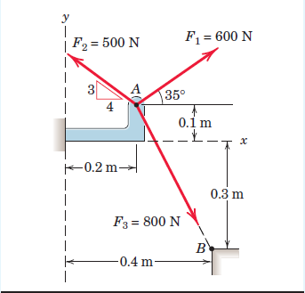


3.

Slide 34

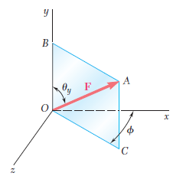

The problems considered in the first part of this chapter involved only two dimensions; they could be formulated and solved in a single plane. In this section and in the remaining sections of the chapter, we will discuss problems involving the three dimensions of space.
Consider a force F acting at the origin O of the system of rectangular coordinates x, y, z. To define the direction of F , we draw the vertical plane OBAC containing F
This plane passes through the vertical y axis; its orientation is defined by the angle f it forms with the xy plane. The direction of F within the plane is defined by the angle u y that F forms with the y axis. The force F may be resolved into a vertical component F y and a horizontal component F h ;
The corresponding scalar components are

Slide 35
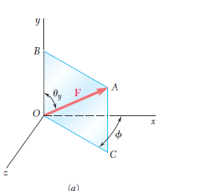
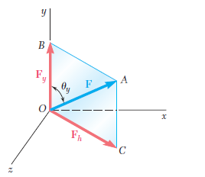
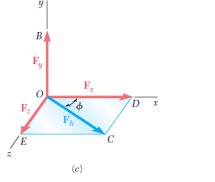

But F h may be resolved into two rectangular components F x and F z along the x and z axes, respectively. This operation, shown in Fig c , is carried out in the xz plane. We obtain the following expressions for the corresponding scalar components:

Slide 36

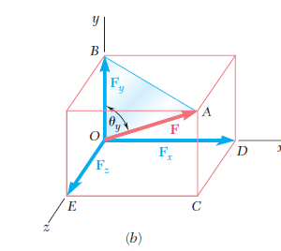

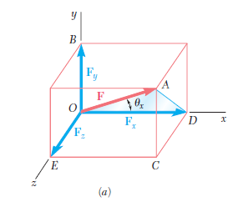
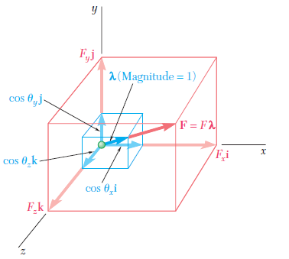
Clearly, the vector λ is a vector whose magnitude is equal to 1 and whose direction is the same as that of F

Slide 37



The vector λ is referred to as the unit vector along the line of action of F

Slide 38

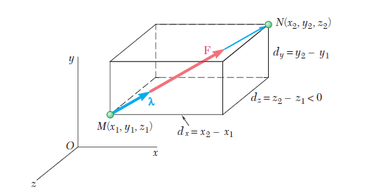



In many applications, the direction of a force F is defined by the coordinates of two points, M ( x 1 , y 1 , z 1 ) and
N ( x 2 , y 2 , z 2 ), located on its line of action
Consider the vector MN joining M and N
and of the same sense as F . Denoting its scalar components by d x , d y ,d z , respectively, we write

Slide 39


from which it follows that the scalar components of F are, respectively

Slide 40
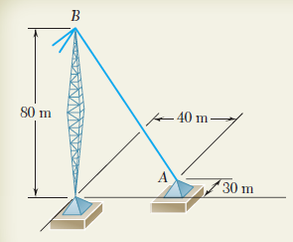

Problem 4

Slide 41
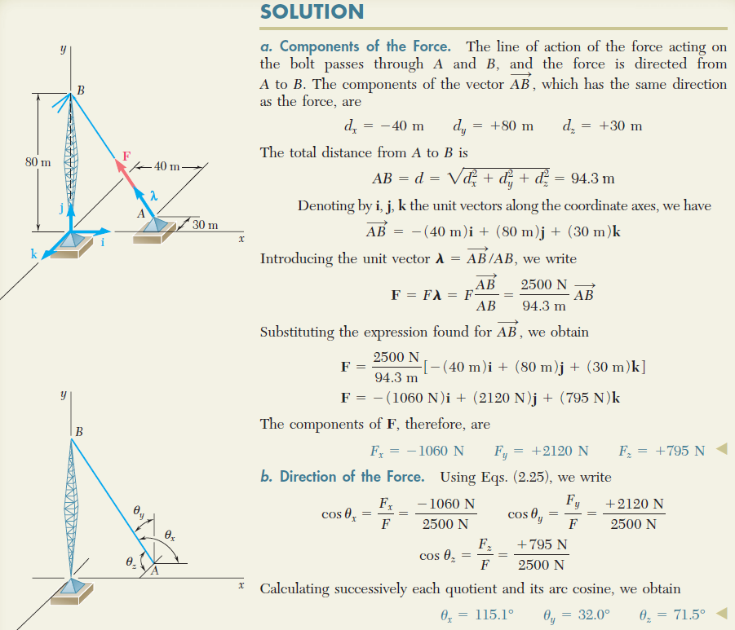

Slide 42
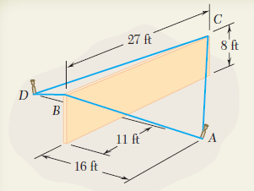
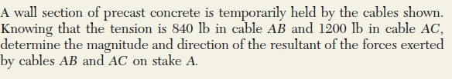
Problem 5

Slide 43
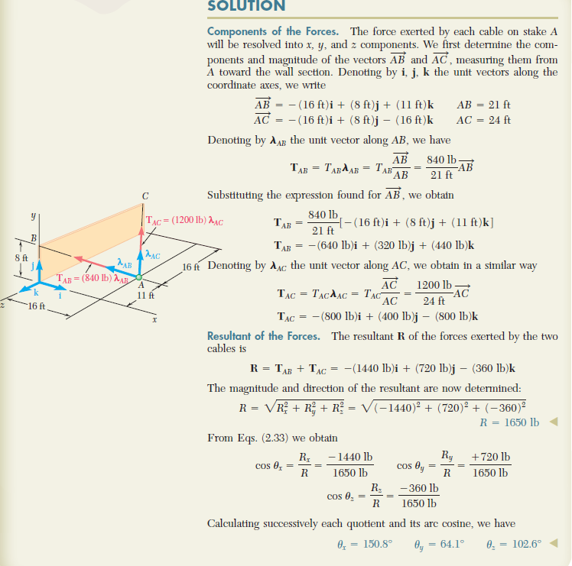

Slide 44
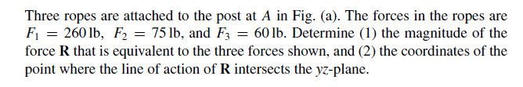
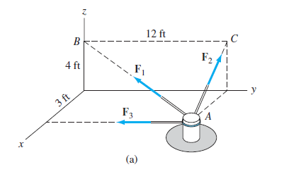
Problem. 6

Slide 45
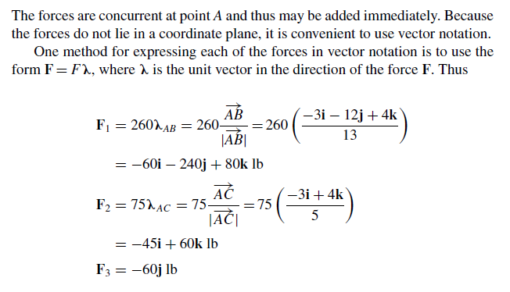
Solution:-

Slide 46
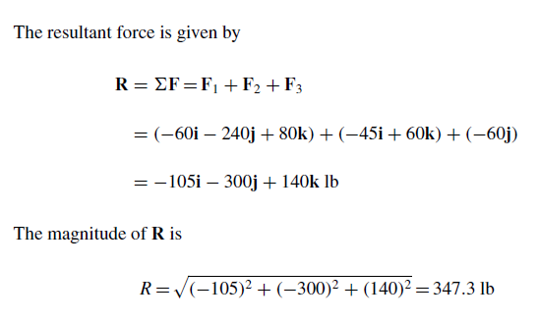

Slide 47

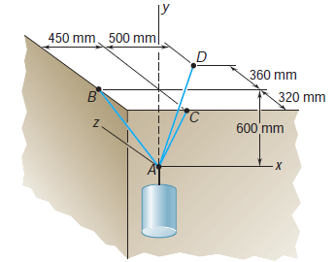

Slide 49
D
(500,600,360)
B
(-450,600,0)
C
(0,600,-320)
A
(0,0,0)
W

Slide 50
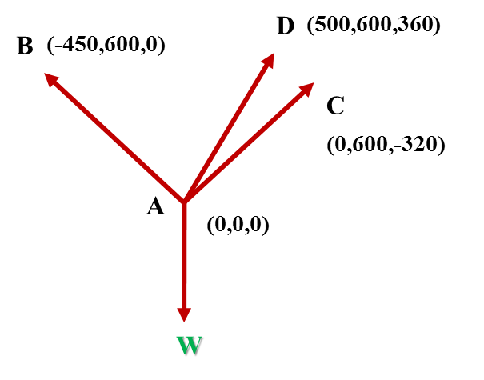

Slide 57

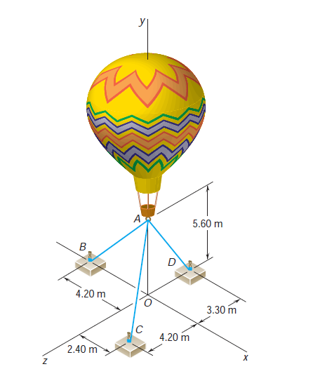

Slide 58
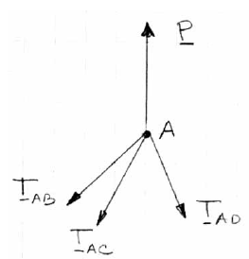
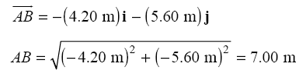
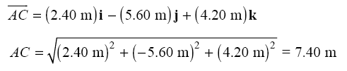

(0,5.6,0)
(-4.2,0,0)
(0,0,-3.3)
(2.4,0,4.2)

Slide 59
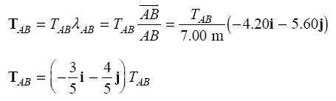
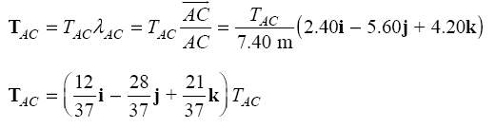
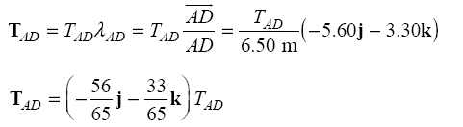

Slide 60



Slide 63
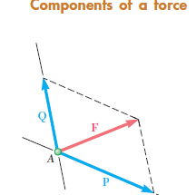
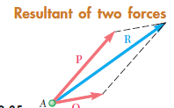


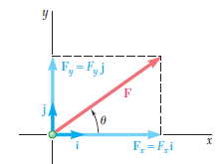




Take away of the chapter

Slide 64


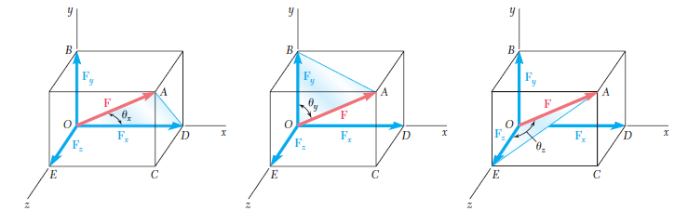
Forces in space
A force F in three-dimensional space can be resolved into rectangular components F x , F y , and F z

Slide 65
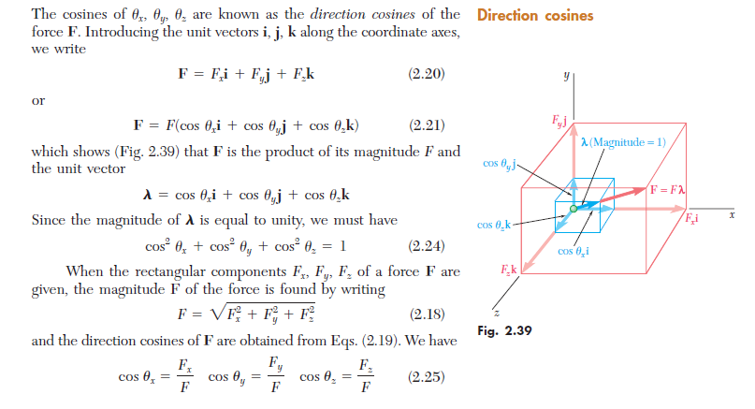

Slide 66
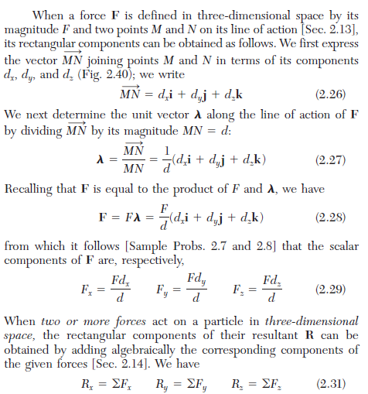
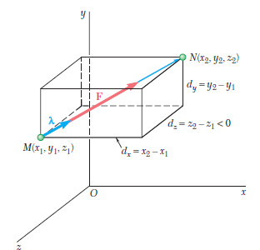

Slide 67
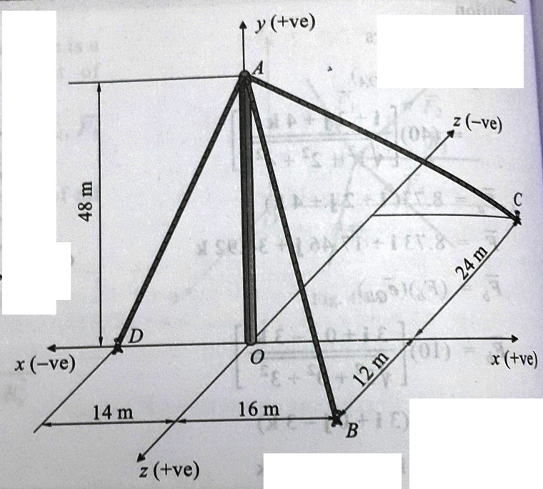
Unsolved 1
Knowing that the tension in AC is T_{AC} = 20 kN, determine the required values of tension T_{AB} and T_{AD} so that the resultant of the three forces applied at A is vertical and calculate resultant.
T_{AB} = 37.09 kN
T_{AD} = 61.12 kN
R = - 110.05 kN

Slide 68
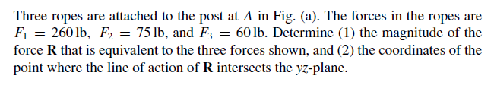
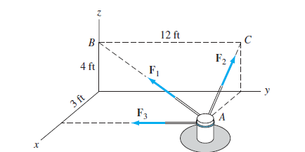


Unsolved 2

Slide 69



Unsolved 3

Slide 70


Unsolved 4

Slide 71

The resultant of the three concurrent space forces at A is R = (-788 j)N. Find the magnitude of F₁, F₂ and F₃ forces.
Unsolved 5
F₁ = 154 N
F₂ = 320 N
F₃= 400 N

